Slide 1
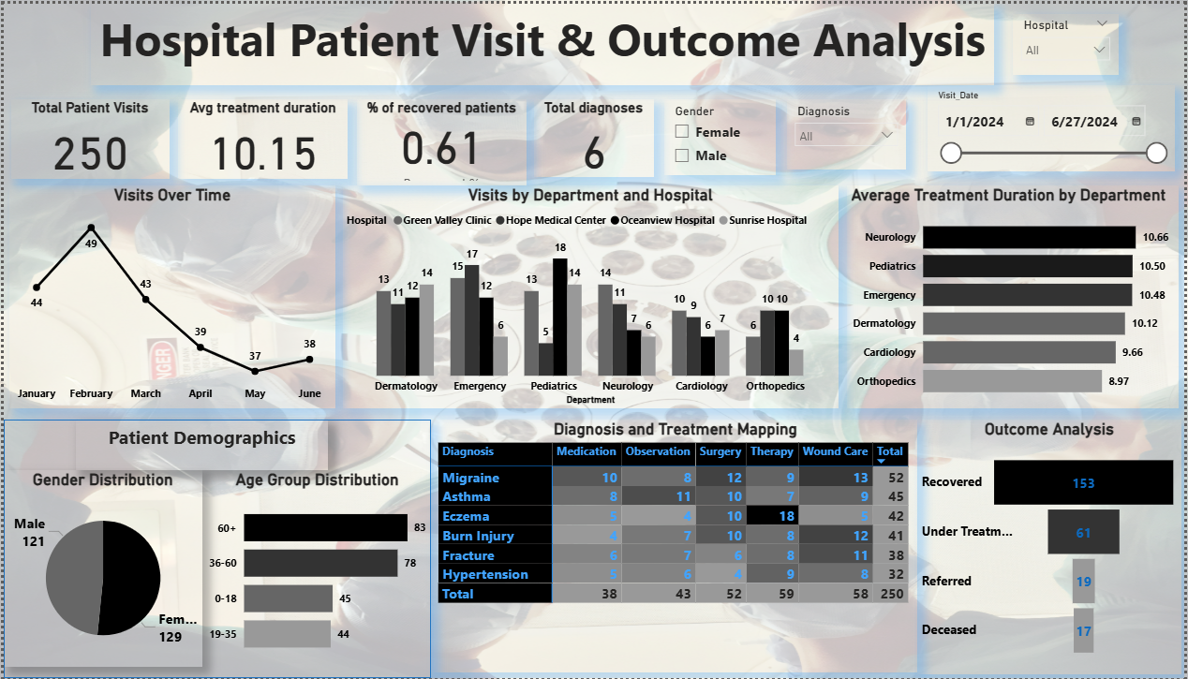
Hospital Patient Visit & Outcome Analysis

Slide 2




Card Visuals
1a. Patient Visit Overview
1d. Total unique diagnoses
1b. What is the Average treatment duration
1c. What is the Percentage of recovered patients

Slide 3
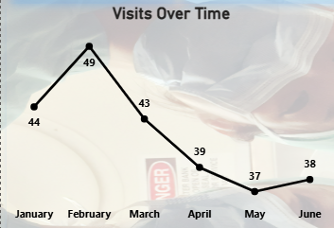
2.What is the Visit Trends?

Slide 4
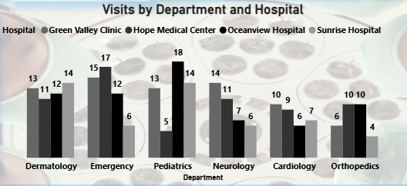
3. Visits by Department and Hospital

Slide 5
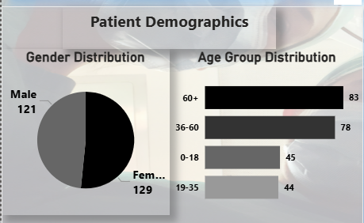
4. Patient Demographics

Slide 6
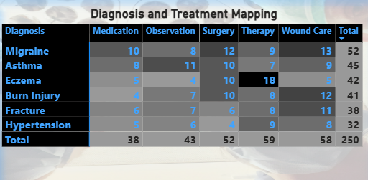
6. Diagnosis & Treatment Matrix

Slide 7
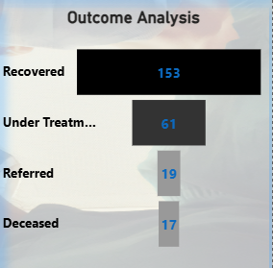
6. Outcome Analysis

Slide 8
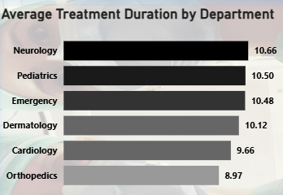
7. Avg. Treatment Duration by Department

Slide 9
Insights
1.High Departmental Load:
The Emergency department in Hospital C recorded the highest number of visits.
Recovery Rate:
Overall recovery rate: 73%. Hospital B has the highest recovery rate (~80%).
Age Group Trends:
Patients aged 19–35 formed the majority of hospital visits (~42%).
Gender Distribution:
Female patients accounted for 54% of total visits.
Treatment Duration:
The average treatment duration was 5.6 days. The Surgery department has the highest avg duration.
Frequent Diagnosis:
Flu and Fractures were the most recurring diagnoses across all hospitals

Slide 10
Recommendations
1.Increase Staffing in Emergency Departments:
Due to high patient inflow and longer average treatment duration.
Optimize Treatment Plans:
For departments with higher durations (e.g., Surgery), consider procedural audits.
Expand Diagnostics for Flu Cases:
Flu being a top diagnosis suggests need for preventive campaigns and seasonal awareness.
Allocate More Resources to Young Adult Services:
Since patients aged 19–35 dominate visits, tailor healthcare packages accordingly.
Further Investigate Gender-Based Outcome Differences:
Minor difference in recovery rates by gender—worth evaluating underlying causes.

